Slide 1
BOM, DOM, and Their Workflow in JavaScript
Understanding Browser and Document Object Models
Presentation By: Aun Zaidi

Slide 2
Introduction
Brief explanation of JavaScript's role in web development
Importance of understanding BOM and DOM
What we'll cover in this presentation

Slide 3
What is the DOM (Document Object Model)?
Definition: DOM is a programming interface for HTML and XML documents
Tree-like structure representation of the document
Platform- and language-independent
Allows programs to manipulate document structure, style, and content

Slide 4
DOM Tree Structure
Visual representation of DOM tree
Document node at the top
HTML element as root
Head and Body as children
Other elements as descendants
Nodes: elements, text, attributes, comments

Slide 5
DOM Manipulation Basics
Common DOM methods:
getElementById(), getElementsByClassName()
querySelector(), querySelectorAll()
createElement(), appendChild()
removeChild(), replaceChild()

Slide 6
DOM Events
Event handling in DOM
Common events: click, load, mouseover, keypress
Event listeners: addEventListener()
Event propagation: bubbling and capturing

Slide 7
What is the BOM (Browser Object Model)?
Definition: BOM provides objects for interacting with the browser
Not standardized like DOM (implementation varies by browser)
Includes window, navigator, screen, location, history objects

Slide 8
BOM Components
Window object: Top-level object representing browser window
Navigator object: Browser information (name, version, etc.)
Screen object: User's display properties
Location object: Current URL and navigation methods
History object: Browser history navigation

Slide 9
Window Object Deep Dive
Properties: window.innerHeight, window.innerWidth
Methods: window.alert(), window.prompt(), window.open()
Timers: setTimeout(), setInterval()

Slide 10
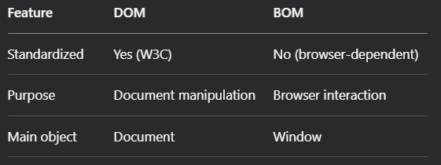
DOM vs. BOM

Slide 11
Workflow in JavaScript
Browser loads HTML and creates DOM
JavaScript accesses/modifies DOM
JavaScript interacts with BOM for browser features
Event-driven programming model

Slide 12
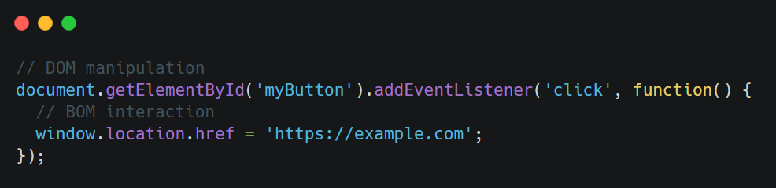
Practical Example

Slide 13
Best Practices
Minimize DOM manipulation (use document fragments)
Cache DOM references
Use event delegation
Be mindful of cross-browser BOM differences

Slide 14
Common Pitfalls
Not waiting for DOM to be ready (DOMContentLoaded)
Overusing global window object
Memory leaks from event listeners
Assuming BOM features exist in all browsers

Slide 15
Modern Alternatives
Virtual DOM (React, Vue)
Browser APIs that extend BOM capabilities
Frameworks that abstract some BOM/DOM operations

Slide 16
Conclusion
DOM manipulates page content, while BOM controls browser behavior.
Together, they enable dynamic, interactive web experiences.
Mastering both is essential for front-end development.
Modern frameworks rely on these core JavaScript concepts.
Keep experimenting to deepen your understanding!
Final Tip: "Use DevTools to explore BOM/DOM in real-time!"

